Slide 1



Concurrent & Networked Software Design Dimensions: Part 1
Douglas C. Schmidt
d.schmidt@vanderbilt.edu
www.dre.vanderbilt.edu/~schmidt
Professor of Computer Science
Institute for Software Integrated Systems Vanderbilt University Nashville, Tennessee, USA

Slide 2
Topics Covered in this Part of the Module
Discuss key communication design dimensions
Evaluate the pros & cons of alternative designs that apps & services can use to interact
Communication
Service
Service
Service
Service
Service
Service
Concurrency
Configuration

Slide 3
Topics Covered in this Part of the Module
Discuss key communication design dimensions
Evaluate the pros & cons of alternative designs that apps & services can use to interact
Focus is on communication design at the middleware & OS layers
Applications
Domain-Specific
Middleware Services
Common
Middleware Services
Distribution
Middleware
Host Infrastructure
Middleware
Operating Systems
& Protocols
Hardware

Slide 4
Topics Covered in this Part of the Module
Discuss key communication design dimensions
Evaluate the pros & cons of alternative designs that apps & services can use to interact
Focus is on communication design at the middleware & OS layers
Software developers at these layers need to understand how to program these design alternatives
Applications
Domain-Specific
Middleware Services
Common
Middleware Services
Distribution
Middleware
Host Infrastructure
Middleware
Operating Systems
& Protocols
Hardware

Slide 5
Topics Covered in this Part of the Module
Discuss key communication design dimensions
Evaluate the pros & cons of alternative designs that apps & services can use to interact
Focus is on communication design at the middleware & OS layers
Software developers at these layers need to understand how to program these design alternatives
Software developers at higher layers may need to know how to configure the middleware & OS communication mechanisms
Applications
Domain-Specific
Middleware Services
Common
Middleware Services
Distribution
Middleware
Host Infrastructure
Middleware
Operating Systems
& Protocols
Hardware
www.dre.vanderbilt.edu/~schmidt/PDF/daemon-design-94.pdf has more info

Slide 6
Connection-oriented vs. Connectionless Protocols
A communication protocol is a set of rules that specify how control & data information is exchanged between computing systems
See en.wikipedia.org/wiki/Communications_protocol for more info

Slide 7
Connection-oriented vs. Connectionless Protocols
A communication protocol is a set of rules that specify how control & data information is exchanged between computing systems
Host A
TCP 3-way handshake
Host B
SYN
SYN/ACK
ACK
… reliable data transfer …
(1) Connection-oriented protocol
Provides a reliable, sequenced, non-duplicated delivery service
Pros: Supports apps that can’t tolerate data loss
Cons: Connection set up incurs some delay & requires state on end points
See en.wikipedia.org/wiki/Connection-oriented_protocol for more info

Slide 8
Connection-oriented vs. Connectionless Protocols
A communication protocol is a set of rules that specify how control & data information is exchanged between computing systems
Host A
TCP 3-way handshake
Host B
Host A
Host B
SYN
sendto()
recvfrom()
SYN/ACK
recvfrom()
sendto()
ACK
… reliable data transfer …
(1) Connection-oriented protocol
(2) Connectionless protocol
Provides a reliable, sequenced, non-duplicated delivery service
Pros: Supports applications that can’t tolerate data loss
Cons: Connect set up incurs some delay & requires state on each end point
Provides an unreliable service in which each datagram can be routed & delivered independently
Pros: Requires less state to implement & lower delay to initiate
Cons: Datagrams can be lost or reordered
See en.wikipedia.org/wiki/Connectionless_protocol for more info

Slide 9
Data Encoding Strategies
GET /cs282/ka.jpg HTTP/1.0 Connection: Keep-Alive User-Agent: Mozilla/5.0 [en] … Host: xar.dre.vanderbilt.edu Accept: image/gif, image/jpeg, */* Accept-Language: en Accept-Charset: iso-8859-1,*,utf-8
...
(1) TEXT-BASED
Text-based protocols are oriented around text strings, rather than binary data structures
Pros: Much easier for humans to read
Cons: More verbose in terms of time & space usage

Slide 10
Data Encoding Strategies
GET /cs282/ka.jpg HTTP/1.0 Connection: Keep-Alive User-Agent: Mozilla/5.0 [en] … Host: xar.dre.vanderbilt.edu Accept: image/gif, image/jpeg, */* Accept-Language: en Accept-Charset: iso-8859-1,*,utf-8
...
module GIOP {
enum MsgType { Request, Reply, ... };
struct MessageHeader {
char magic[4];
Version GIOP_version;
octet byte_order, message_type;
unsigned long message_size;
};
...
(1) TEXT-BASED
(2) Binary
Text-based protocols are oriented around text strings, rather than binary data structures
Pros: Much easier for humans to read
Cons: More verbose in terms of time & space usage
Binary protocols are oriented around binary data structures, rather than text strings
Pros: Faster & smaller since they are intended for machines rather than people
Cons: Hard for humans to read
Some popular protocols combine text & binary encodings

Slide 11
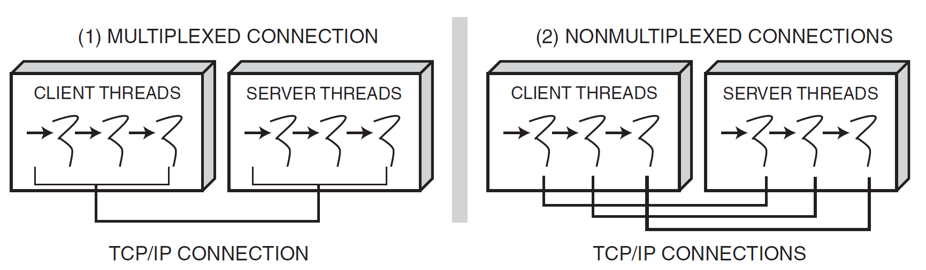
Connection Multiplexing Strategies
(1) Multiplexed connection
All client requests from threads in a process pass through one TCP connection to a server process
Pros: Conserves OS communication resources, such as socket handles & connection control blocks
Cons: Harder to program, less efficient, & less deterministic

Slide 12
Connection Multiplexing Strategies
(1) Multiplexed connection
(2) nonMultiplexed connection
All client requests from threads in a process pass through one TCP connection to a server process
Pros: Conserves OS communication resources, such as socket handles & connection control blocks
Cons: Harder to program, less efficient, & less deterministic
Each client uses a different connection to communicate with a peer service
Pros: Finer control of end-to-end priorities & lower synchronization overhead at middleware & app layers
Cons: Uses more OS resources, & thus may not scale well in certain contexts
See www.dre.vanderbilt.edu/~schmidt/PDF/RT-perf.pdf for more info

Slide 13
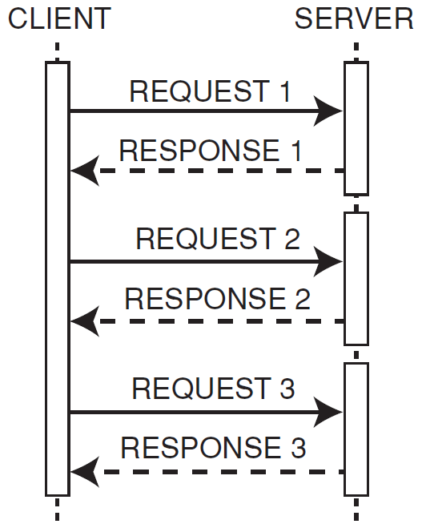
Sync vs. Async Message Exchange
(1) Synchronous message exchange
Exchange messages in a “stop & wait” (synchronous lock-step) sequence
Pros: “Intuitive” since it maps nicely onto function call patterns
Cons: Doesn’t leverage inherent parallelism in the network/system

Slide 14
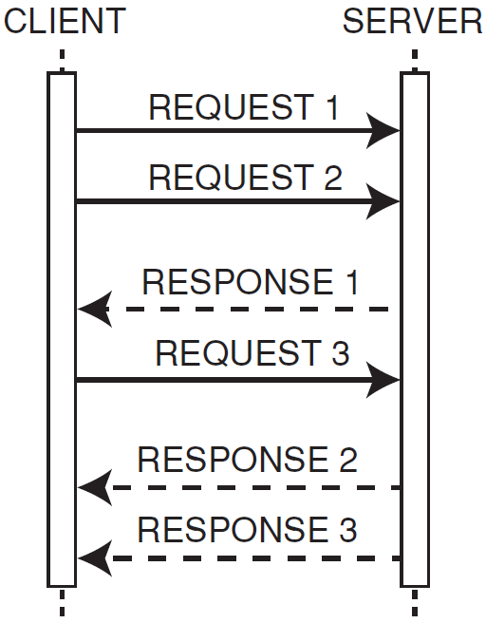
Sync vs. Async Message Exchange
(1) Synchronous message exchange
(2) aSynchronous message exchange
Exchange messages in a “stop & wait” (synchronous lock-step) sequence
Pros: “Intuitive” since it maps nicely onto function call patterns
Cons: Doesn’t leverage inherent parallelism in the network/system
Exchange messages without waiting for responses synchronously
Pros: Leverages inherent parallelism more effectively
Cons: Harder to program & requires a way to detect lost or failed requests & (potentially) resend them later
ami1.pdf & ami2.pdf www.dre.vanderbilt.edu/~schmidt/PDF have more info

Slide 15
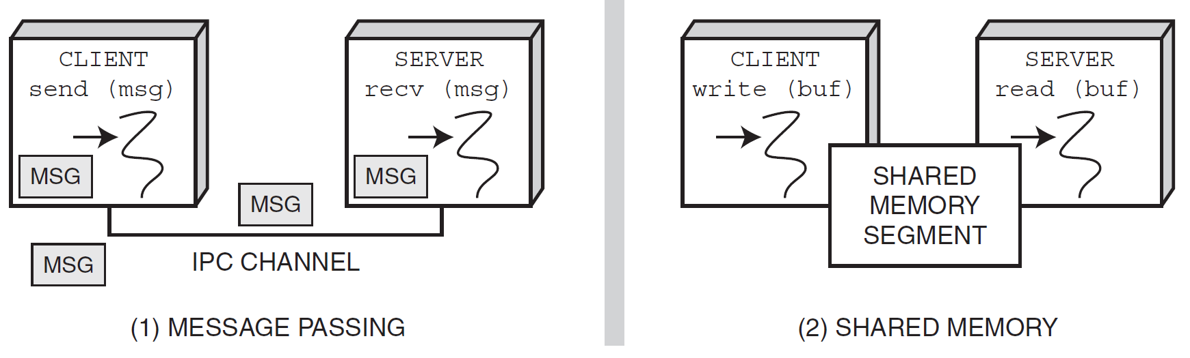
Message Passing vs. Shared Memory
MSG
MSG
MSG
MSG
(1) Message passing
Message passing exchanges data via inter-process communication (IPC) mechanisms
Pros: Generalizes to both local & remote communication
Cons: May incur excess overhead for large messages in a “loop back” configuration

Slide 16
Message Passing vs. Shared Memory
MSG
MSG
SHARED MEMORY SEGMENT
MSG
MSG
(1) Message passing
(2) Shared memory
Message passing exchanges data via inter-process communication (IPC) mechanisms
Pros: Generalizes to both local & remote communication
Cons: May incur excess overhead for large messages in a “loop-back” configuration
Shared memory allows apps to access & exchange data as though they were local to address space of each process
Pros: Can be more efficient for large messages in loop-back configurations
Cons: Doesn’t generalize efficiently to remote systems & can be more error-prone & non-portable for OO apps

Slide 17
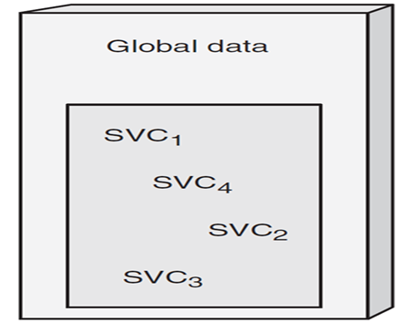
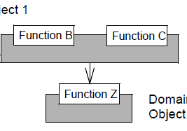
Summary
Separate entities within the single address space of a stand-alone app interact by passing parameters via function/method calls and/or by accessing global variables
Global Data
Function A
Function B
Function C

Slide 18
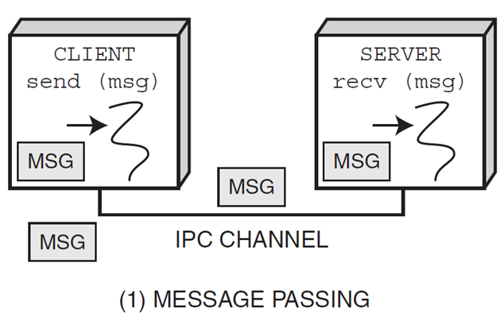
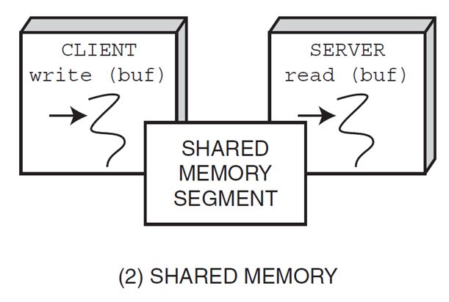

Summary
Separate entities within the single address space of a stand-alone app interact by passing parameters via function/method calls and/or by accessing global variables
Entities located in different address spaces in networked software, however, require more powerful communication mechanisms
MSG
MSG
MSG
MSG
SHARED MEMORY SEGMENT
There are many patterns lurking in these design dimensions, as discussed later

Slide 19
Concurrent & Networked Software Design: Part 2
Douglas C. Schmidt
d.schmidt@vanderbilt.edu
www.dre.vanderbilt.edu/~schmidt
Professor of Computer Science
Institute for Software Integrated Systems Vanderbilt University Nashville, Tennessee, USA

Slide 20
Topics Covered in this Part of the Module
Discuss key communication design dimensions
Evaluate the pros & cons of alternative designs that apps & services can use to interact
Present key service, server, & configuration design dimensions
Evaluate the pros & cons of alternative designs that apps & services can use to organize their structure & configuration
Communication
Service
Service
Service
Service
Service
Service
Concurrency
Configuration
www.dre.vanderbilt.edu/~schmidt/PDF/daemon-design-94.pdf has more info

Slide 21
Service, Server, & Configuration Design Dimensions
When designing concurrent & networked apps, it's important to differentiate between services, servers, & configurations

Slide 22
Service, Server, & Configuration Design Dimensions
When designing concurrent & networked apps, it's important to differentiate between services, servers, & configurations
A service is a capability offered to clients, e.g.:
Web content retrieval
Software distribution
Electronic mail transfer
File access on remote machines
Network time synchronization
Streaming audio/video
SVC₁
SVC₂
SVC₃

Slide 23
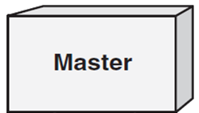
Service, Server, & Configuration Design Dimensions
When designing concurrent & networked apps, it's important to differentiate between services, servers, & configurations
A service is a capability offered to clients
A server is the mechanism by which the service is offered
Provides the units of resource allocation, protection, & computation
SVC₁
SVC₂
SVC₃
SVC₁

Slide 24
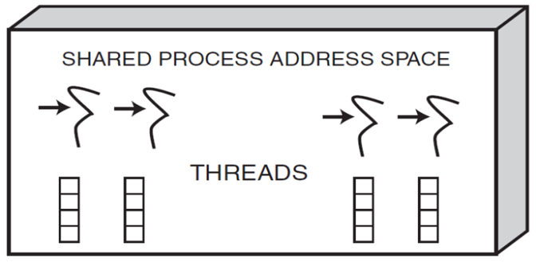
Service, Server, & Configuration Design Dimensions
When designing concurrent & networked apps, it's important to differentiate between services, servers, & configurations
A service is a capability offered to clients
A server is the mechanism by which the service is offered
A configuration binds services together in various structural arrangements at various points of time
Runs in context of server(s)
SVC₁
SVC₂
SVC₃
SVC₁
SVC₁
SVC₂
SVC₃

Slide 25

Short- vs. Long-duration Services
Short-duration services execute in brief, relatively fixed, amounts of time & may handle a single request at a time
Notes:
http://en.wikipedia.org/wiki/File:Stopwatch2.jpg

Slide 26
Short- vs. Long-duration Services
Short-duration services execute in brief, relatively fixed, amounts of time & may handle a single request at a time
Examples of short-duration services include
Computing current time of day
Resolving the Ethernet number of an IP address
Retrieving a disk block from the cache of a network file server
Notes:
http://en.wikipedia.org/wiki/File:Stopwatch2.jpg

Slide 27
Short- vs. Long-duration Services
Short-duration services execute in brief, relatively fixed, amounts of time & may handle a single request at a time
Examples of short-duration services include
Computing current time of day
Resolving the Ethernet number of an IP address
Retrieving a disk block from the cache of a network file server
To minimize the time spent setting up a connection, short-duration services are sometimes implemented using connectionless protocols
e.g., UDP/IP
Notes:
http://en.wikipedia.org/wiki/File:Stopwatch2.jpg

Slide 28

Short- vs. Long-duration Services
Long-duration services run for extended, often variable, amounts of time
They may handle numerous requests during their lifetime
Notes:
http://www.flickr.com/photos/94805433@N00/407591133/

Slide 29
Short- vs. Long-duration Services
Long-duration services run for extended, often variable, amounts of time
They may handle numerous requests during their lifetime
Examples of long-duration services include
Downloading software releases via SFTP or HTTP
Streaming audio & video from a server using RTSP
Performing remote file system backups over a network
Notes:
http://www.flickr.com/photos/94805433@N00/407591133/

Slide 30
Short- vs. Long-duration Services
Long-duration services run for extended, often variable, amounts of time
They may handle numerous requests during their lifetime
Examples of long-duration services include
Downloading software releases via SFTP or HTTP
Streaming audio & video from a server using RTSP
Performing remote file system backups over a network
Long-duration services are often implemented via connection-oriented protocols
e.g., TCP/IP
Notes:
http://www.flickr.com/photos/94805433@N00/407591133/

Slide 31
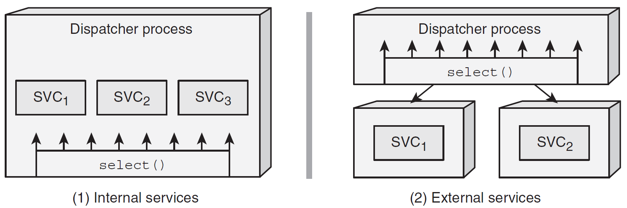
Internal vs. External Services
SVC₁
SVC₂
SVC₃
select()
(1) Internal services
Internal services execute in the same address space as the server that receives the request
Pros: Communication & synchronization between internal services can be very efficient
Cons: Rogue services can cause problems for co-located services

Slide 32
Internal vs. External Services
select()
SVC₁
SVC₂
SVC₃
SVC₁
SVC₂
select()
(1) Internal services
(2) External services
Internal services execute in the same address space as the server that receives the request
Pros: Communication & synchronization between internal services can be very efficient
Cons: Rogue services can cause problems for co-located services
External services execute in different process address spaces
Pros: They are generally more robust than internal services since they are isolated from each other
Cons: IPC & synchronization overhead is higher

Slide 33
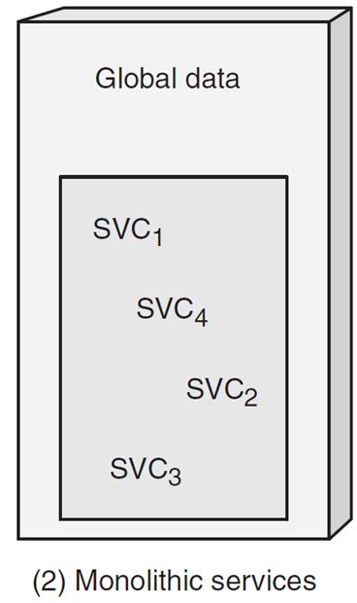
Monolithic vs. Layered/Modular Services
SVC₁
SVC₂
SVC₃
SVC₄
(1) Monolithic services
Monolithic services are tightly coupled clumps of functionality that aren't organized hierarchically
Pros: They may be more efficient
Cons: They are harder to understand, evolve, & maintain

Slide 34
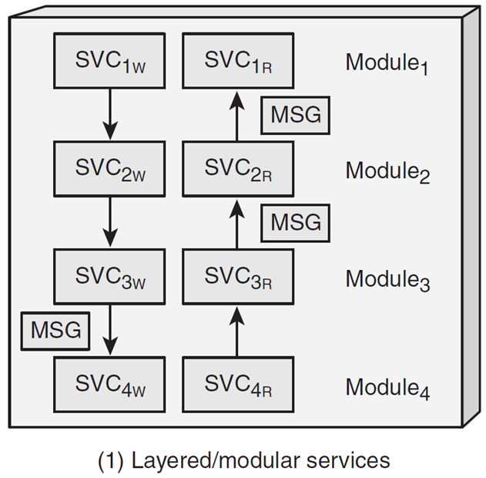
Monolithic vs. Layered/Modular Services
SVC_{1W}
SVC_{1R}
MSG
SVC₁
SVC_{2W}
SVC_{2R}
SVC₂
MSG
SVC_{3W}
SVC_{3R}
SVC₃
MSG
SVC₄
SVC_{4W}
SVC_{4R}
(1) Monolithic services
(2) layered/modular services
Monolithic services are tightly coupled clumps of functionality that aren't organized hierarchically
Pros: They may be more efficient
Cons: They are harder to understand, evolve, & maintain
Layered/modular services can be decomposed into partitioned & hierarchically related tasks
Pros: They are generally easier to understand, evolve, & maintain
Cons: Layers may incur overhead

Slide 35
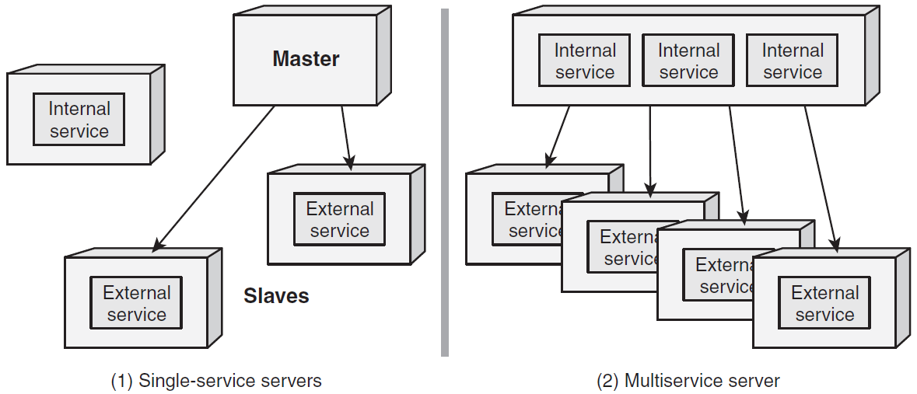
Single-service vs. Multi-service Servers
Parent
Internal service
Child
(1) single-service server
Single-service servers offer only one service
Pros: Separation of concerns
Cons:
Consumes excess OS resources
Redundant infrastructure code
Manual shutdown & restart
Inconsistent administration

Slide 36
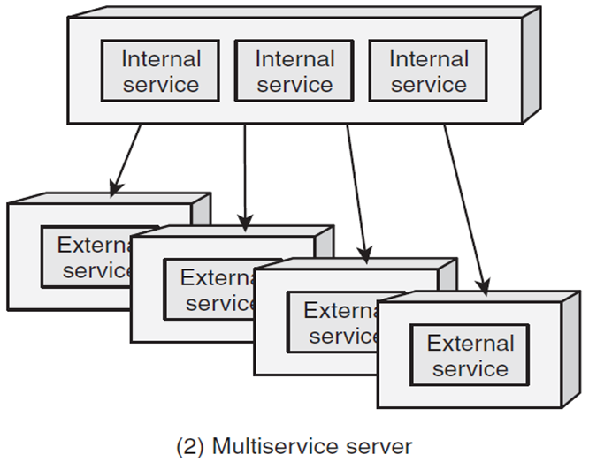
Single-service vs. Multi-service Servers
Internal service
Internal service
Internal service
Parent
Internal service
Child
(1) single-service server
(2) multi-service server
Single-service servers offer only one service
Pros: Separation of concerns
Cons:
Consumes excess OS resources
Redundant infrastructure code
Manual shutdown & restart
Inconsistent administration
Integrate multiple-services into a “super-server”
Super-server spawns external services on-demand
Pros: The inverse of single-service server deficiencies
Cons: “One-size-fits-all” constraints

Slide 37
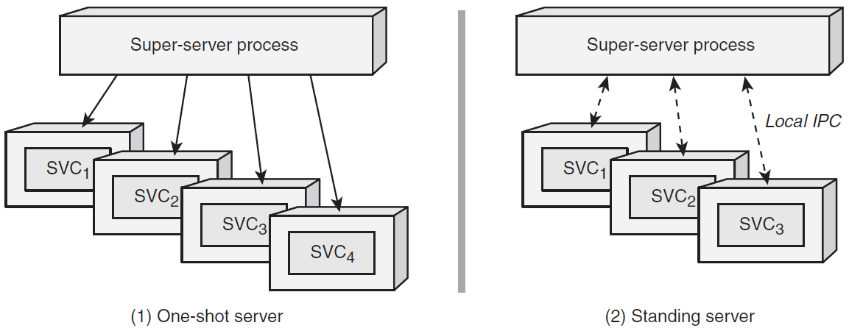
One-shot vs. Standing Servers
Super-server process
(1) one-shot server
One-shot servers are spawned on demand & perform service requests in a separate thread or process
Typically terminates after completion of request or session that triggered it
Pros: Lower resource utilization
Cons: Startup latency

Slide 38
One-shot vs. Standing Servers
Super-server process
Super-server process
(1) one-shot server
(2) standing server
One-shot servers are spawned on demand & perform service requests in a separate thread or process
Typically terminates after completion of request or session that triggered it
Pros: Lower resource utilization
Cons: Startup latency
Standing servers continue to run beyond lifetime of any service request or session they process
Typically initiated at boot time or by a super-server after the first client request
Pros: Amortized startup latency
Cons: Higher resource utilization

Slide 39
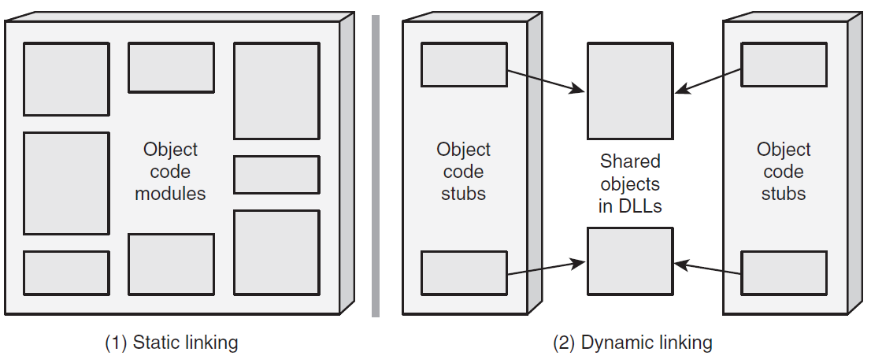
Static vs. Dynamic Linking & Configuration
SVC₁
SVC₁
SVC₃
SVC₃
SVC₂
SVC₂
(1) Static configuration
Binds all object files at compile time and/or static link time
Pros & cons: Trades off increased runtime performance for larger executable sizes

Slide 40
Static vs. Dynamic Linking & Configuration
SVC₁
SVC₁
SVC₂
SVC₁
SVC₂
SVC₁
SVC₁
SVC₃
SVC₃
SVC₃
SVC₃
SVC₃
SVC₂
SVC₂
SVC₂
(1) Static configuration
(2) Dynamic configuration
Binds all object files at compile time and/or static link time
Pros & cons: Trades off increased runtime performance for larger executable sizes
(Un)loads object files from/to an address space when program is launched/updated
Pros: Can reduce memory usage & increase flexibility
Cons: Increased run-time overhead & potential security risks
www.dre.vanderbilt.edu/~schmidt/PDF/Svc-Conf.pdf has more info

Slide 41
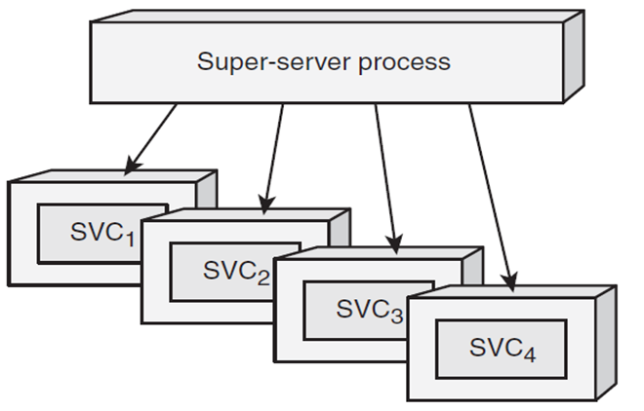
Summary
Two key groups of design dimensions related to successful development & deployment of networked apps & services include:
Service/server design dimensions affect ways in which app services are structured, developed, & instantiated
Super-server process

Slide 42
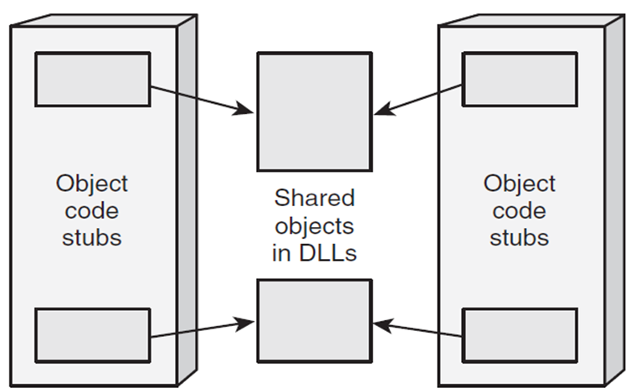
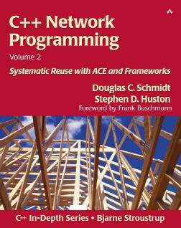
Summary
Two key groups of design dimensions related to successful development & deployment of networked apps & services include:
Service/server design dimensions affect ways in which app services are structured, developed, & instantiated
Service configuration design dimensions affect ability to vary run-time placement & binding of app services after delivery & deployment
SVC₁
SVC₁
SVC₂
SVC₂
SVC₃
SVC₃
There are many patterns lurking in these design dimensions, as discussed later

Slide 43
Concurrent & Networked Software Design: Part 3
Douglas C. Schmidt
d.schmidt@vanderbilt.edu
www.dre.vanderbilt.edu/~schmidt
Professor of Computer Science
Institute for Software Integrated Systems Vanderbilt University Nashville, Tennessee, USA

Slide 44
Topics Covered in this Part of the Module
Discuss key communication design dimensions
Evaluate the pros & cons of alternative designs that apps & services can use to interact
Present key service, server, & configuration design dimensions
Evaluate the pros & cons of alternative designs that apps & services can use to organize their structure & configuration
Explore key concurrency design dimensions
Evaluate the pros & cons of alternative designs that apps & services can use to perform computations in processes and/or threads
Communication
Service
Service
Service
Service
Service
Service
Concurrency
Configuration
www.dre.vanderbilt.edu/~schmidt/PDF/daemon-design-94.pdf has more info

Slide 45
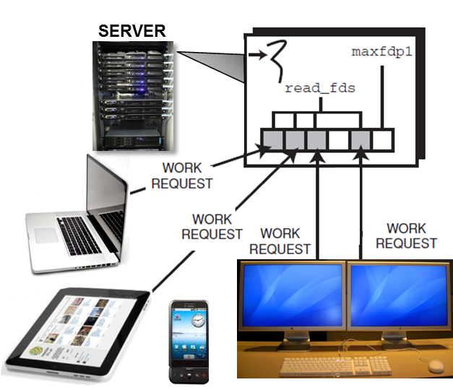
Iterative vs. Concurrent Servers
(1) Iterative server
Handle each client request before servicing subsequent requests
Pros: Simplicity
Cons: Non-scalable

Slide 46
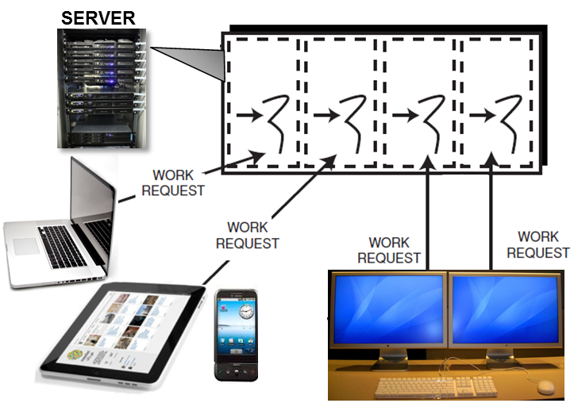
Iterative vs. Concurrent Servers
(1) Iterative server
(2) Concurrent server
Handle each client request before servicing subsequent requests
Pros: Simplicity
Cons: Non-scalable
Handle multiple requests from clients simultaneously
Pros: Scalable
Cons: Complexity
See www.dre.vanderbilt.edu/~schmidt/PDF/Reactor1-93.pdf for more info

Slide 47
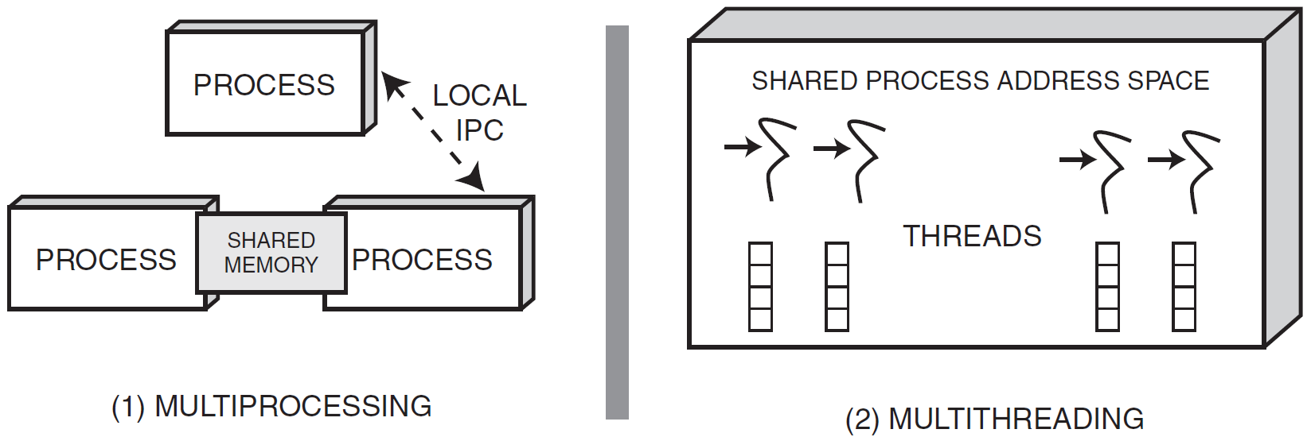
Multiprocessing vs. Multithreading
Shared Memory
(1) multiprocessing
A process is the unit of resource allocation & protection
A process manages certain resources
e.g., virtual memory, I/O handles, & signal handlers
Pros: Process is protected from other processes via an MMU
Cons: IPC between processes can be complicated & inefficient

Slide 48
Multiprocessing vs. Multithreading
Shared Memory
(1) multiprocessing
(2) multithreading
A process is the unit of resource allocation & protection
A process manages certain resources
e.g., virtual memory, I/O handles, & signal handlers
Pros: Process is protected from other processes via an MMU
Cons: IPC between processes can be complicated & inefficient
A thread is the unit of computation that runs in the context of a process
A thread manages certain resources
e.g., stack, registers, signal masks, priorities, & thread-specific data
Pros: IPC between threads is more efficient than IPC between processes
Cons: Threads can interfere with each other

Slide 49

Thread/Process Pool Eager Spawning Strategies
Prespawn OS threads/processes to amortize creation costs via eager spawning strategies:
See kircher-schwanninger.de/michael/publications/EagerAcquisition.pdf for info
Notes:
http://www.flickr.com/photos/71401718@N00/6206823614/

Slide 50
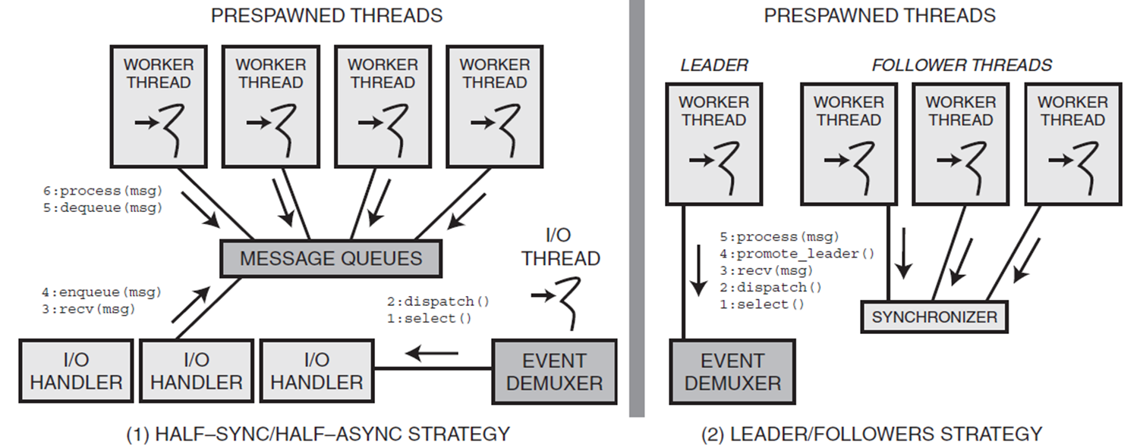
Thread/Process Pool Eager Spawning Strategies
Prespawn OS threads/processes to amortize creation costs via eager spawning strategies:
Message Queues
Event Demuxer
(1) half-sync/half-async strategy
Pros: Scalability
Cons: Synchronization, context switching, & data movement overhead

Slide 51
Thread/Process Pool Eager Spawning Strategies
Prespawn OS threads/processes to amortize creation costs via eager spawning strategies:
Message Queues
Synchronizer
Event Demuxer
Event Demuxer
(1) half-sync/half-async strategy
(2) leader/followers strategy
Pros: Scalability
Cons: Synchronization, context switching, & data movement overhead
Pros: Less overhead & greater predictability
Cons: Less scalable
See HS-HA.pdf & LF.pdf at www.dre.vanderbilt.edu/~schmidt/PDF

Slide 52

On-demand Thread/Process Spawning Strategy
On-demand spawning creates a new thread or process in response to the arrival of client connection and/or data requests
See kircher-schwanninger.de/michael/publications/LazyAcquisition.pdf for info
Notes:
http://www.flickr.com/photos/92435716@N00/101890434/

Slide 53
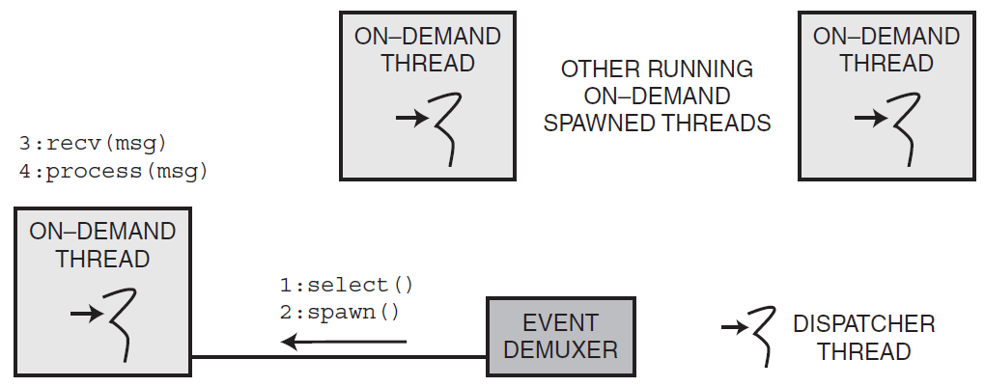
On-demand Thread/Process Spawning Strategy
On-demand spawning creates a new thread or process in response to the arrival of client connection and/or data requests
Used to implement thread-per-request & thread-per-connection models
Event Demuxer
Pros: Reduced wasted resource consumption of unused prespawned threads
Cons: Can degrade performance in heavily loaded servers & determinism due to overhead of spawning processes/threads & starting services
See http://www.dre.vanderbilt.edu/~schmidt/PDF/PDCP.pdf for more info

Slide 54




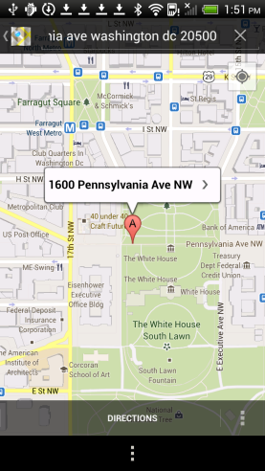



Kernel- & User-level Threading Models
OS scheduling ensures apps use host CPU/core resources appropriately

Slide 55
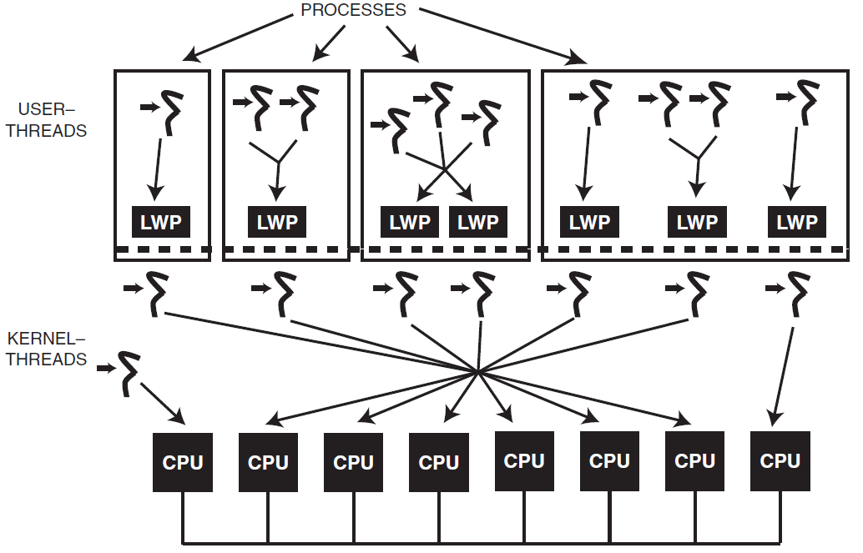
Kernel- & User-level Threading Models
OS scheduling ensures apps use host CPU/core resources appropriately
Modern OS platforms provide various models for scheduling threads
A key difference between the models is the contention scope in which threads compete for system resources, such as CPU time
CPU Core
CPU Core
CPU Core
CPU Core
CPU Core
CPU Core
CPU Core
CPU Core

Slide 56
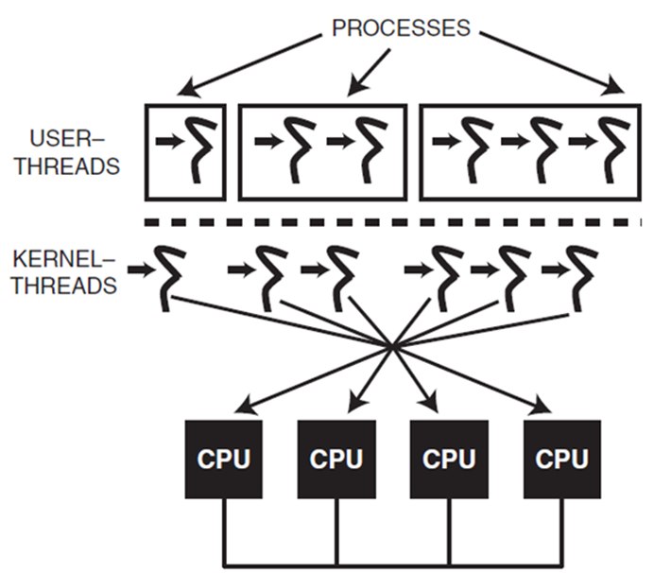
Kernel- & User-level Threading Models
OS scheduling ensures apps use host CPU/core resources appropriately
Modern OS platforms provide various models for scheduling threads
A key difference between the models is the contention scope in which threads compete for system resources, such as CPU time
The two different contention scopes include:
System contention scope (aka “kernel threading”) where threads compete directly with other system- scope threads, regardless of what process they’re in
Pros: Can leverage hardware parallelism effectively
Cons: Higher thread creation & context switching overhead
Note 1:1 mapping between user & kernel threads
CPU Core
CPU Core
CPU Core
CPU Core

Slide 57
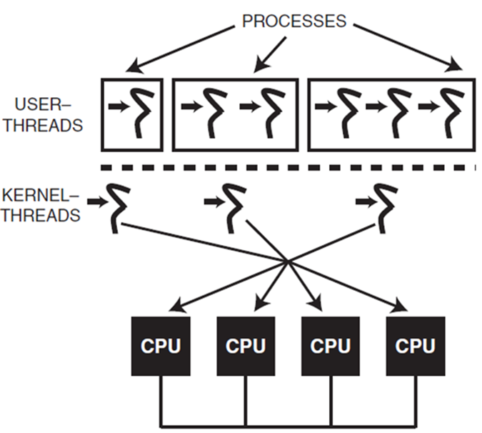
Kernel- & User-level Threading Models
OS scheduling ensures apps use host CPU/core resources appropriately
Modern OS platforms provide various models for scheduling threads
A key difference between the models is the contention scope in which threads compete for system resources, such as CPU time
The two different contention scopes include:
Process contention scope (aka “user threading”) where threads in the same process compete with each other (but not directly with threads in other processes)
Pros: Lower thread creation & context switching overhead
Cons: Can’t leverage hardware parallelism effectively & has odd blocking semantics
Note N:1 mapping between user & kernel threads
CPU Core
CPU Core
CPU Core
CPU Core

Slide 58
Hybrid Threading Model
The hybrid-threading model combines the kernel- & user-level threading models
When an app spawns a thread, it indicates thread’s contention scope
Note N:M mapping between user & kernel threads
CPU Core
CPU Core
CPU Core
CPU Core
CPU Core
CPU Core
CPU Core
CPU Core
See en.wikipedia.org/wiki/Scheduler_activations for more info

Slide 59
Hybrid Threading Model
The hybrid-threading model combines the kernel- & user-level threading models
When an app spawns a thread, it indicates thread’s contention scope
The OS creates a user-space thread, but only creates a kernel thread if needed or if the app explicitly requests system contention scope
Note N:M mapping between user & kernel threads
CPU Core
CPU Core
CPU Core
CPU Core
CPU Core
CPU Core
CPU Core
CPU Core

Slide 60
Hybrid Threading Model
The hybrid-threading model combines the kernel- & user-level threading models
When an app spawns a thread, it indicates thread’s contention scope
The OS creates a user-space thread, but only creates a kernel thread if needed or if the app explicitly requests system contention scope
Note N:M mapping between user & kernel threads
CPU Core
CPU Core
CPU Core
CPU Core
CPU Core
CPU Core
CPU Core
CPU Core
Pros: Highly flexible & configurable
Cons: Complex to implement & use effectively
See ftp://crimson.ihg.uni-duisburg.de/Solaris/docs/multi_thread.pdf for more

Slide 61
Task- vs. Message-based Architectures
A concurrency architecture is a binding between:
CPUs/cores, which provide the execution context for application code

Slide 62
Task- vs. Message-based Architectures
A concurrency architecture is a binding between:
CPUs/cores, which provide the execution context for application code
Data & control messages, which are sent & received from one or more applications & network devices
MSG
MSG
MSG

Slide 63
Task- vs. Message-based Architectures
A concurrency architecture is a binding between:
CPUs/cores, which provide the execution context for application code
Data & control messages, which are sent & received from one or more applications & network devices
Processing tasks, which perform services on messages as they arrive & depart
MSG
MSG
MSG
SVC

Slide 64
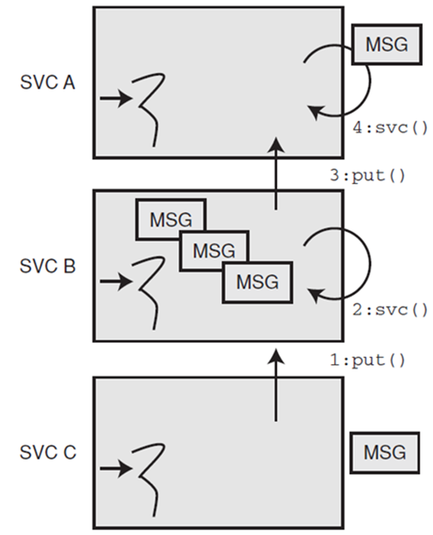
Task- vs. Message-based Architectures
A concurrency architecture is a binding between:
CPUs/cores, which provide the execution context for application code
Data & control messages, which are sent & received from one or more applications & network devices
Processing tasks, which perform services on messages as they arrive & depart
Two common concurrency architectures are
Task-based architectures structure multiple CPUs/cores according to units of service functionality in an app
Pros: Straightforward to program
Cons: High synchronization, context switching, & data movement overhead
MSG
SVC₁
MSG
MSG
SVC₂
MSG
SVC₃
MSG
(1) task-based concurrency architecture
See en.wikipedia.org/wiki/Pipeline_(software) for more info

Slide 65
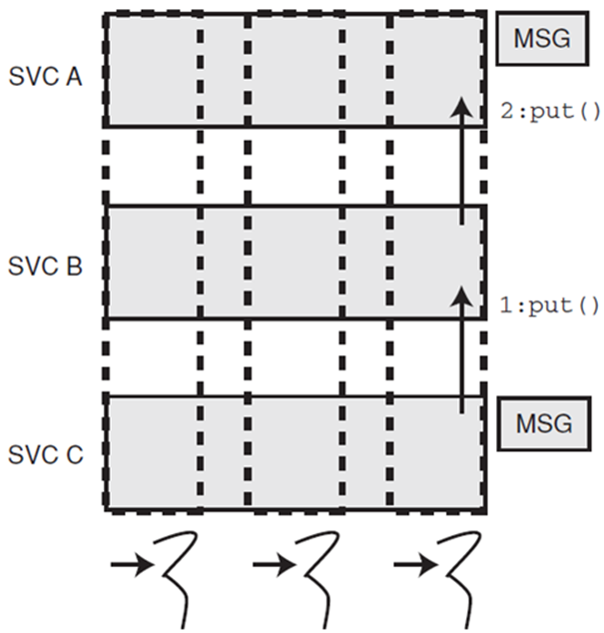
Task- vs. Message-based Architectures
A concurrency architecture is a binding between:
CPUs/cores, which provide the execution context for application code
Data & control messages, which are sent & received from one or more applications & network devices
Processing tasks, which perform services on messages as they arrive & depart
Two common concurrency architectures are
Message-based architectures structure the CPUs/cores according to messages received from apps & network devices
Pros: Lower overhead
Cons: Less intuitive design structure
MSG
SVC₁
SVC₂
MSG
SVC₃
(2) message-based concurrency architecture
See www.dre.vanderbilt.edu/~schmidt/PDF/INFOCOM-94.pdf for more info

Slide 66
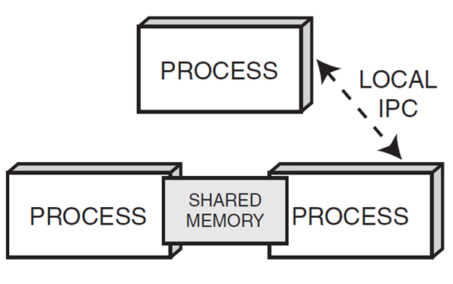
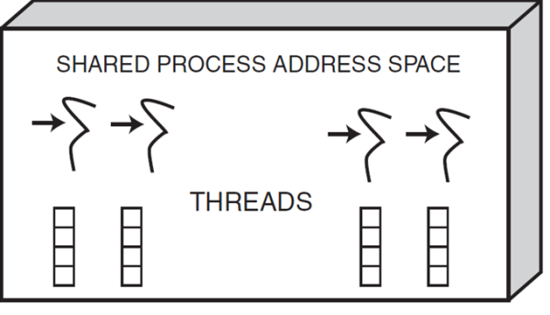
Summary
Concurrent & networked software may associate one or more OS processes or threads with one or more services
Shared Memory
Shared Memory

Slide 67
Summary
Concurrent & networked software may associate one or more OS processes or threads with one or more services
These factors require design decisions in a number of dimensions that affect
Thread & process structure
CPU/core usage
Synchronization & scheduling behavior
App performance & robustness
Shared Memory
Shared Memory
Shared Memory
Shared Memory
There are many patterns lurking in these design dimensions, as discussed later

